Slide 1
Comparing artefact catalogues in Historical Archaeology
Penny Crook
La Trobe University
Notes:
Focus on structures not vocabularies

Slide 2
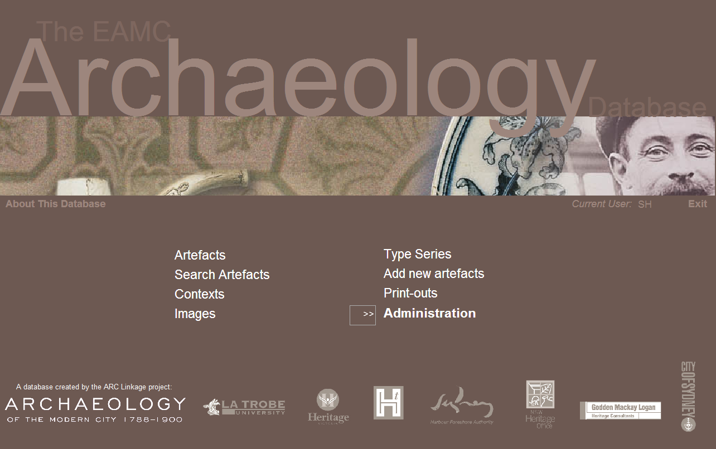

Slide 3
Exploring the Archaeology of Modern City (EAMC)
www.latrobe.edu.au/amc
ARC Linkage project (2001–2004…6)
Two customised MS Access databases
700K artefacts, 7K contexts, 5K images
Designed in-house for project use
By-products of research process
Released in 2006
Data entry at your own risk
Data structure is as a ‘standard’ even though it wasn’t developed as one

Slide 4
Assessment Report
Assessed research potential of 7 sites
Quality audit of 3% assemblage
Found high degree of suspected and surprising
Data entry ‘errors’, misused categories and systemic ‘differences’
Result: data upgrade at 3 sites (www.latrobe.edu.au/amc)

Slide 5
Post EAMC
Commonwealth Block project (Modern City 2)
Doctoral Research (quality)
Contract work
Other users
Some people use it as (confuse it with) a ‘standard’
Australian Historical Archaeological Database (www.ahad.edu.au)

Slide 6
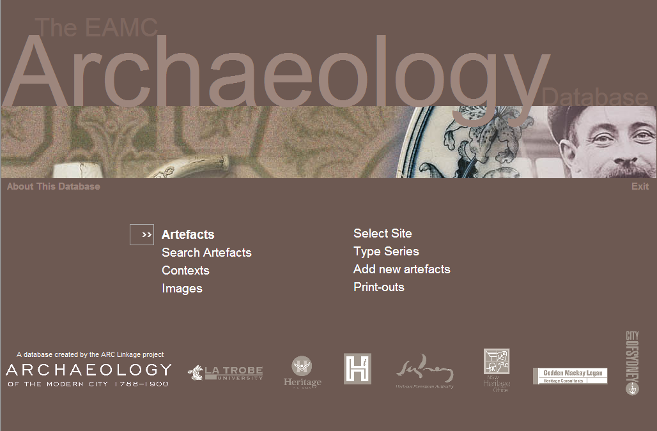
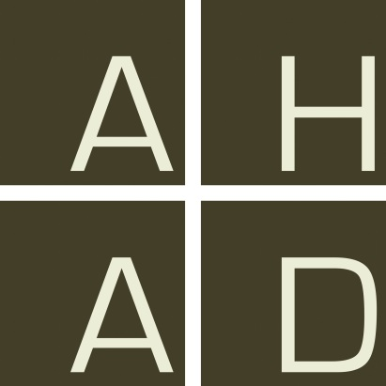

Slide 7
Comparing data structures
No two artefacts are the same
But some are very similar…

Slide 8
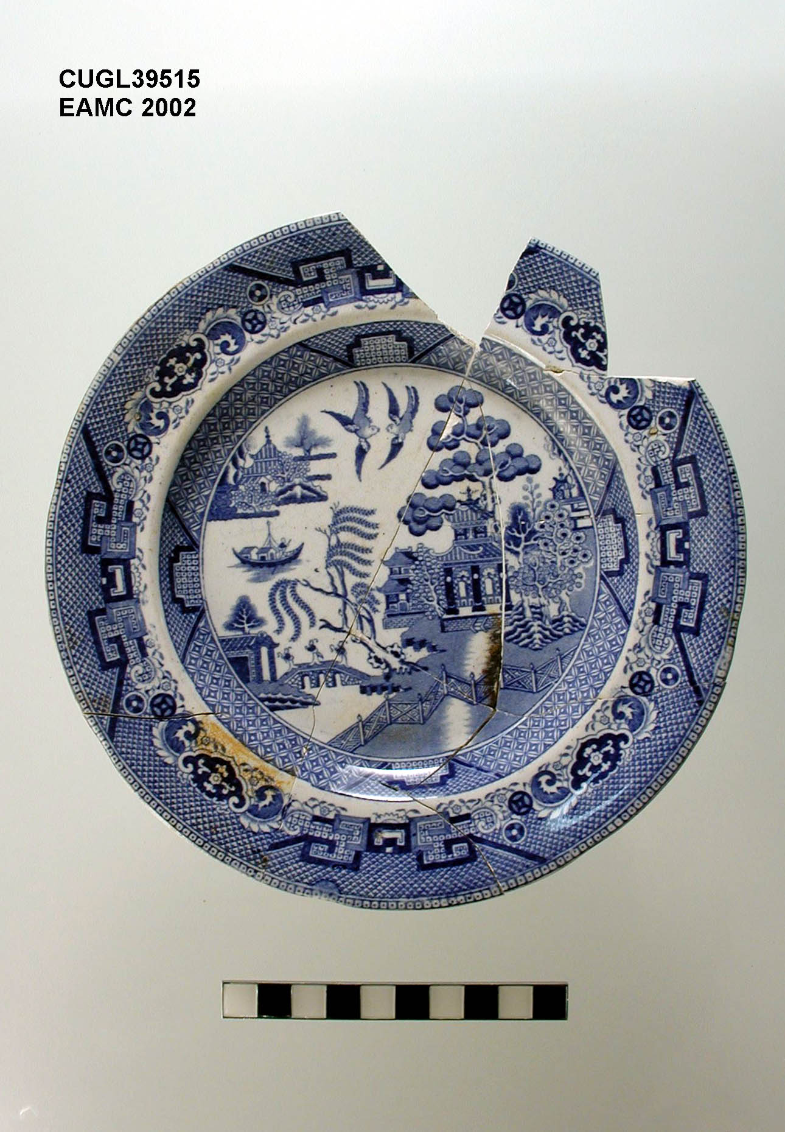

Slide 9
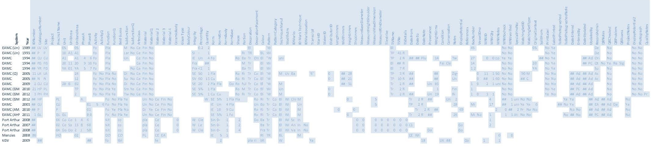

Slide 10
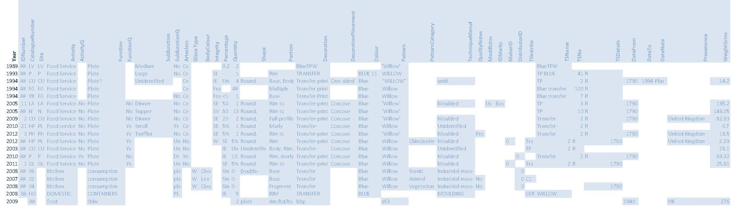

Slide 11
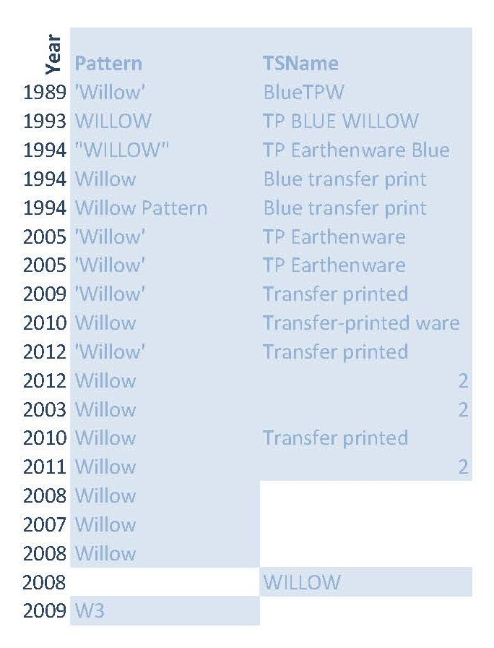

Slide 12
Bugbears
Quantification/Measurement as text
CAPITALS!
Structure data in the Notes field
Codes without coding lists

Slide 13
Other issues
Splitting vs lumping
Questionable, ambiguous and tentative data
Sharing vs Standards

Slide 14
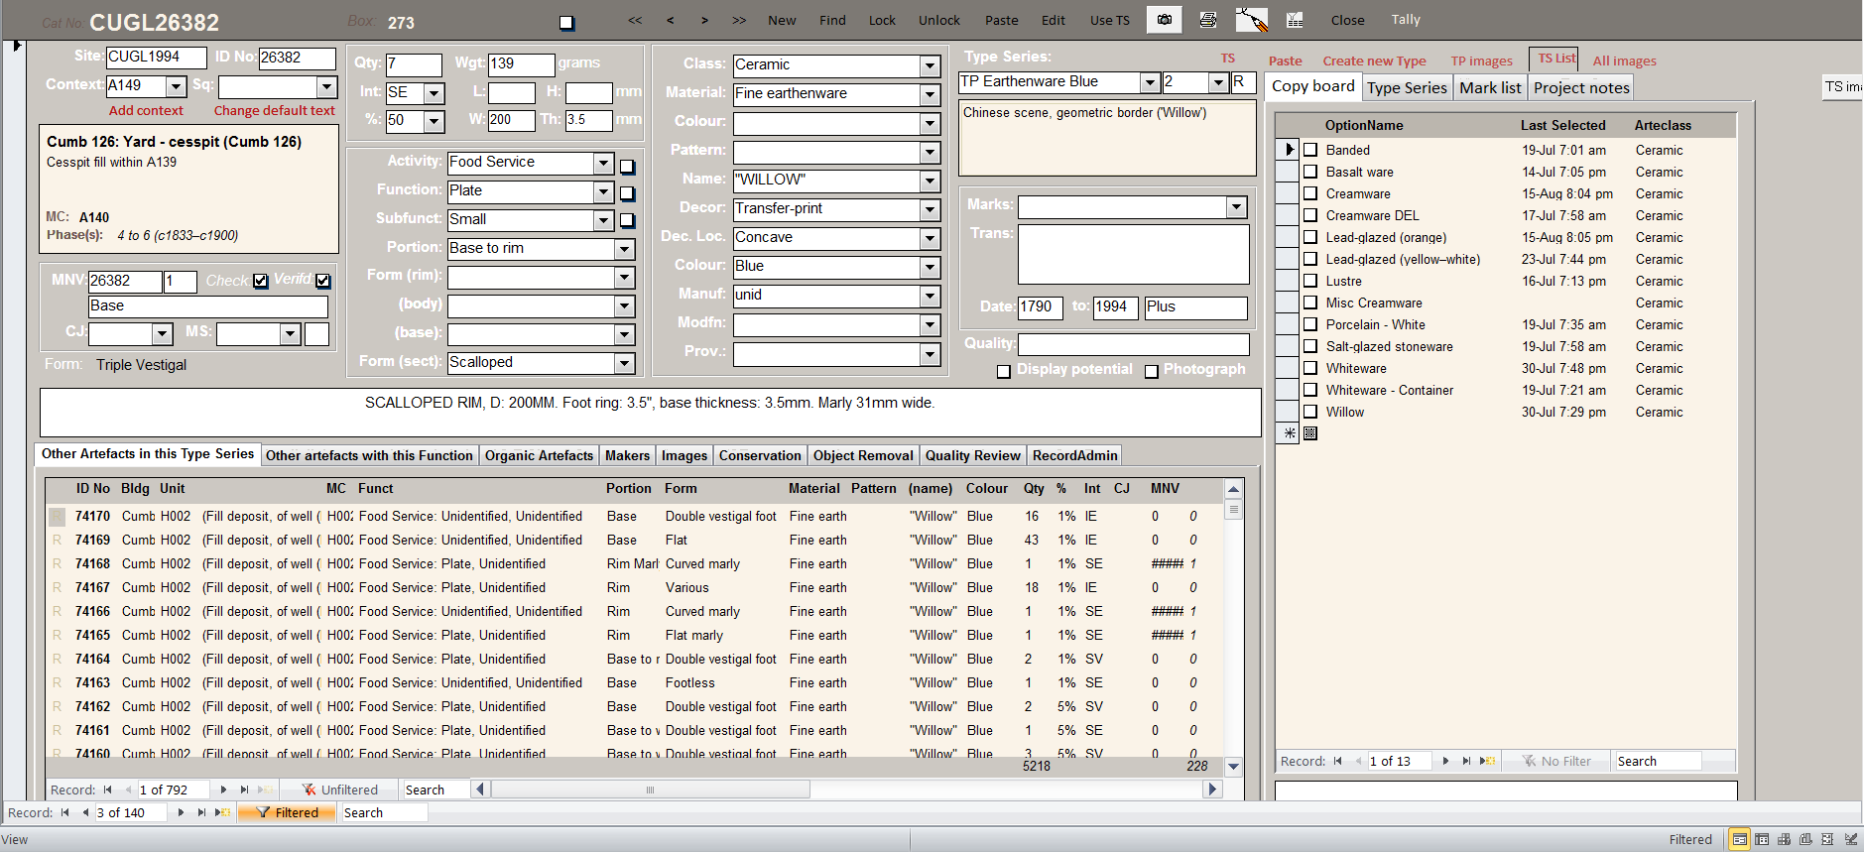

Slide 15
Comparing artefact catalogues in Historical Archaeology
Penny Crook
La Trobe University
Notes:
Focus on structures not vocabularies

